Slide 1
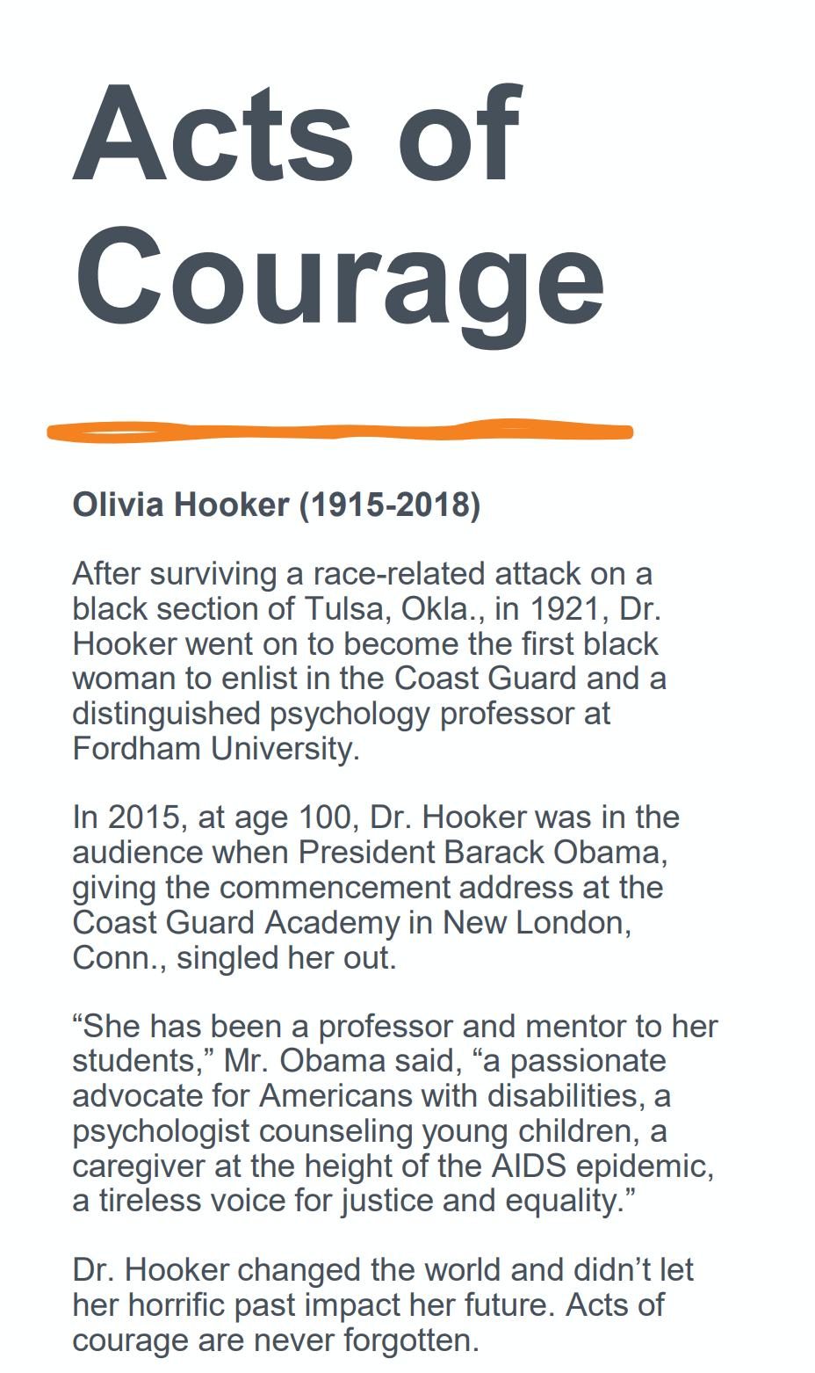
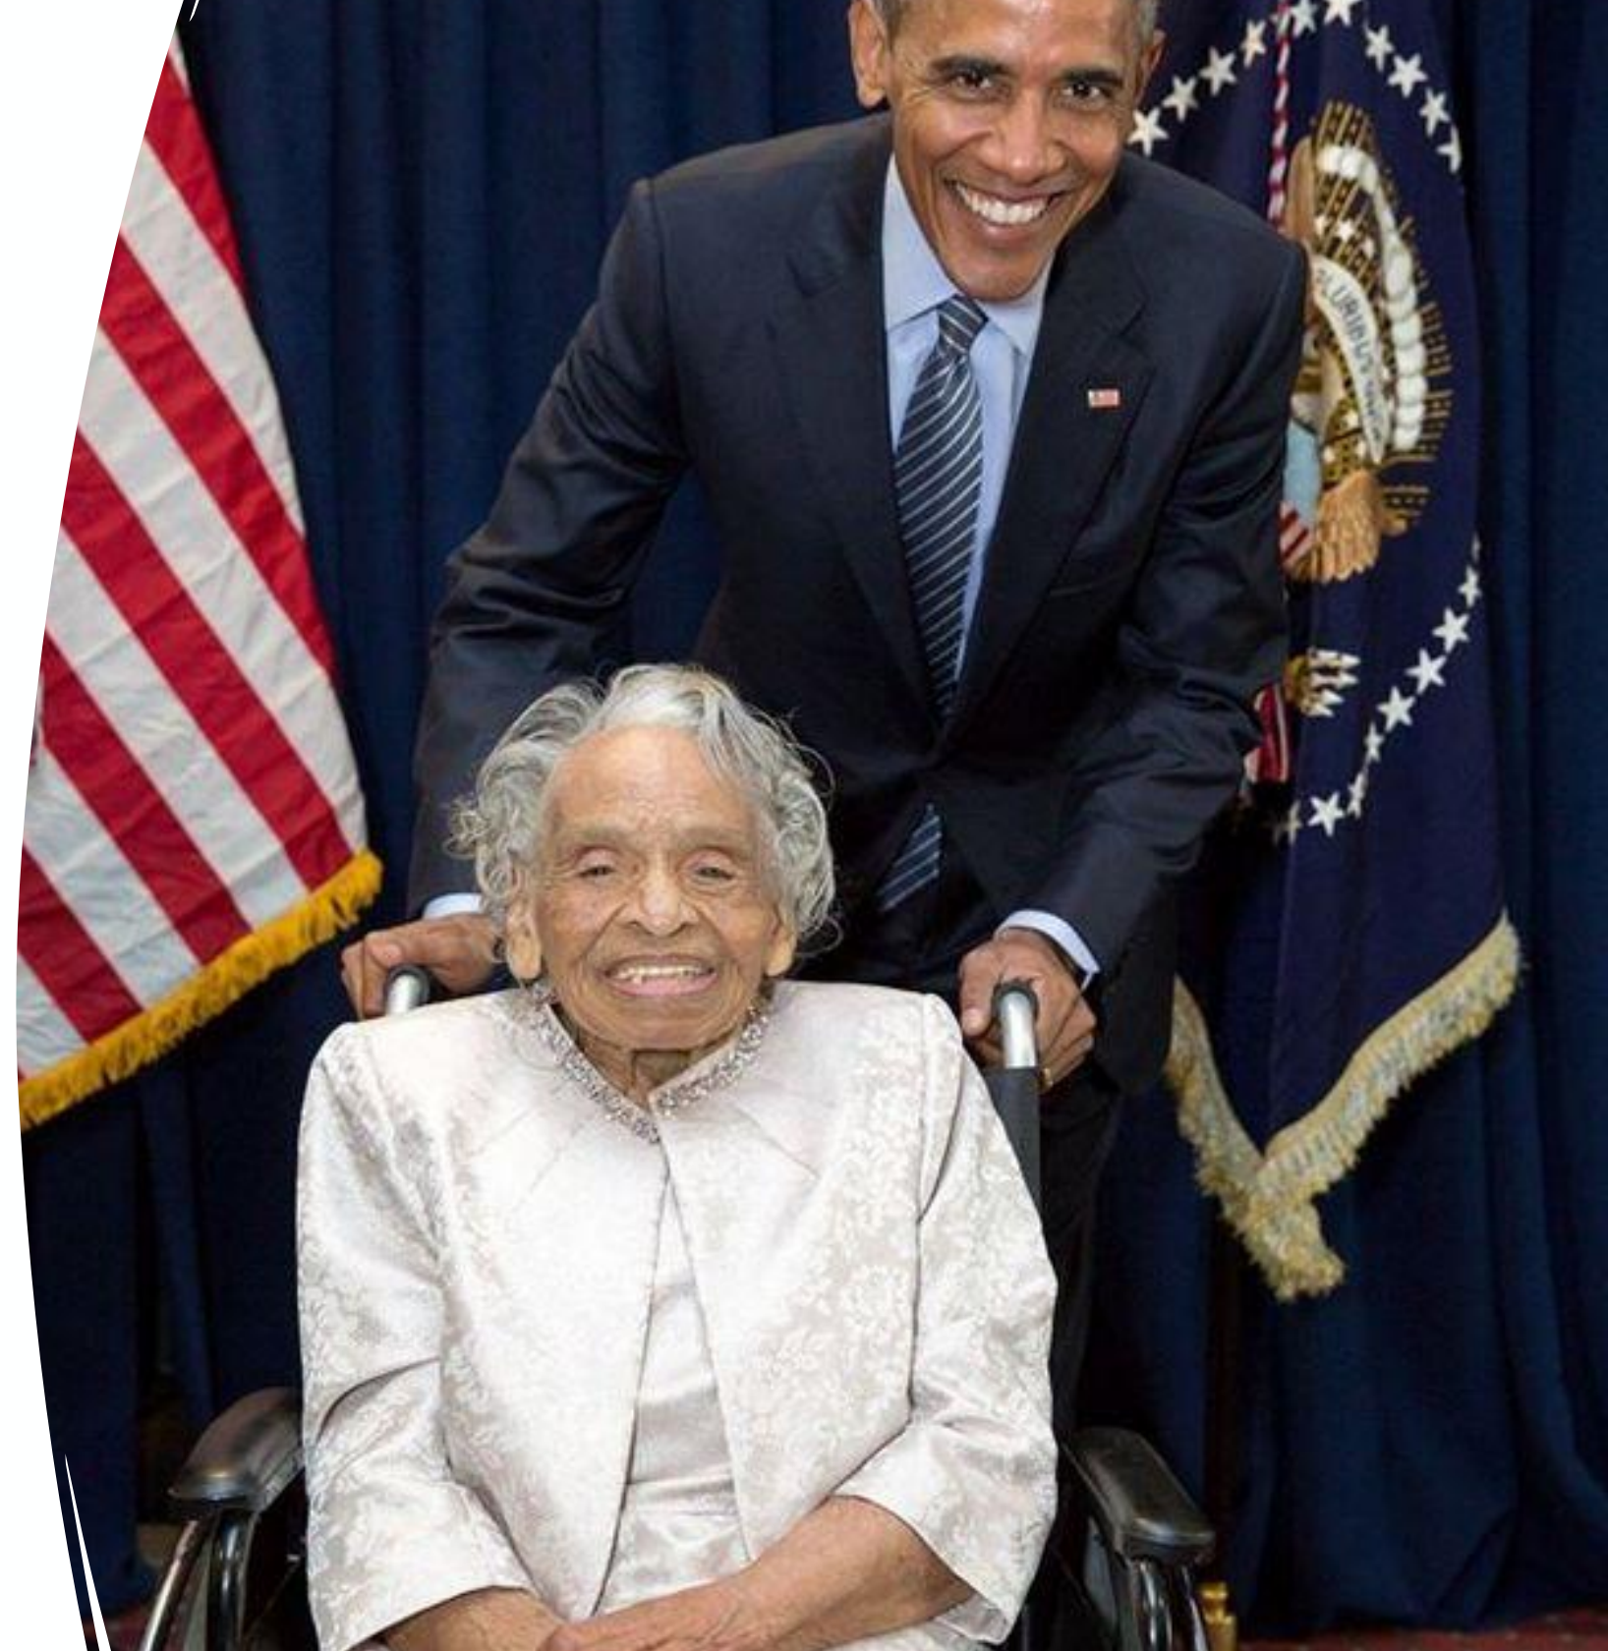

Slide 2
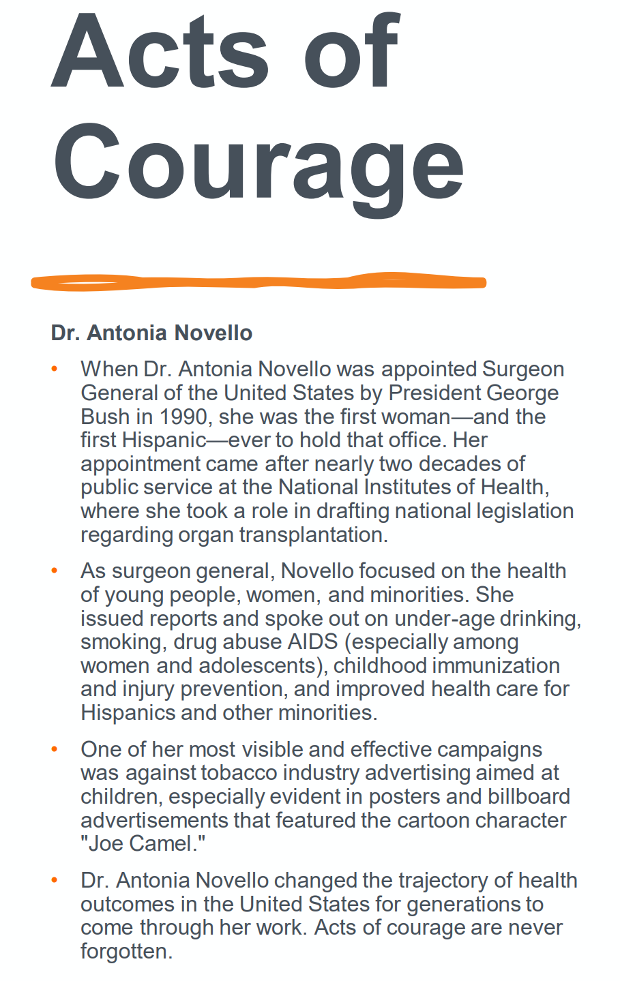
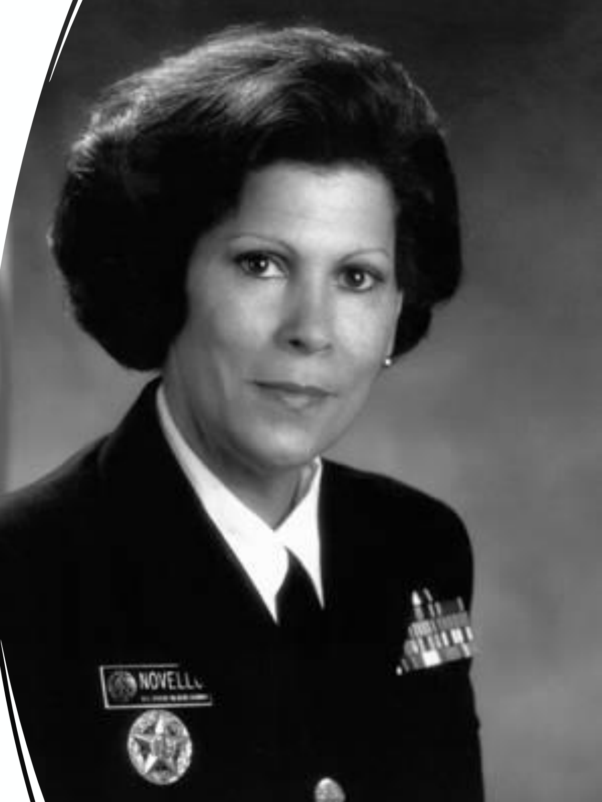

Slide 3
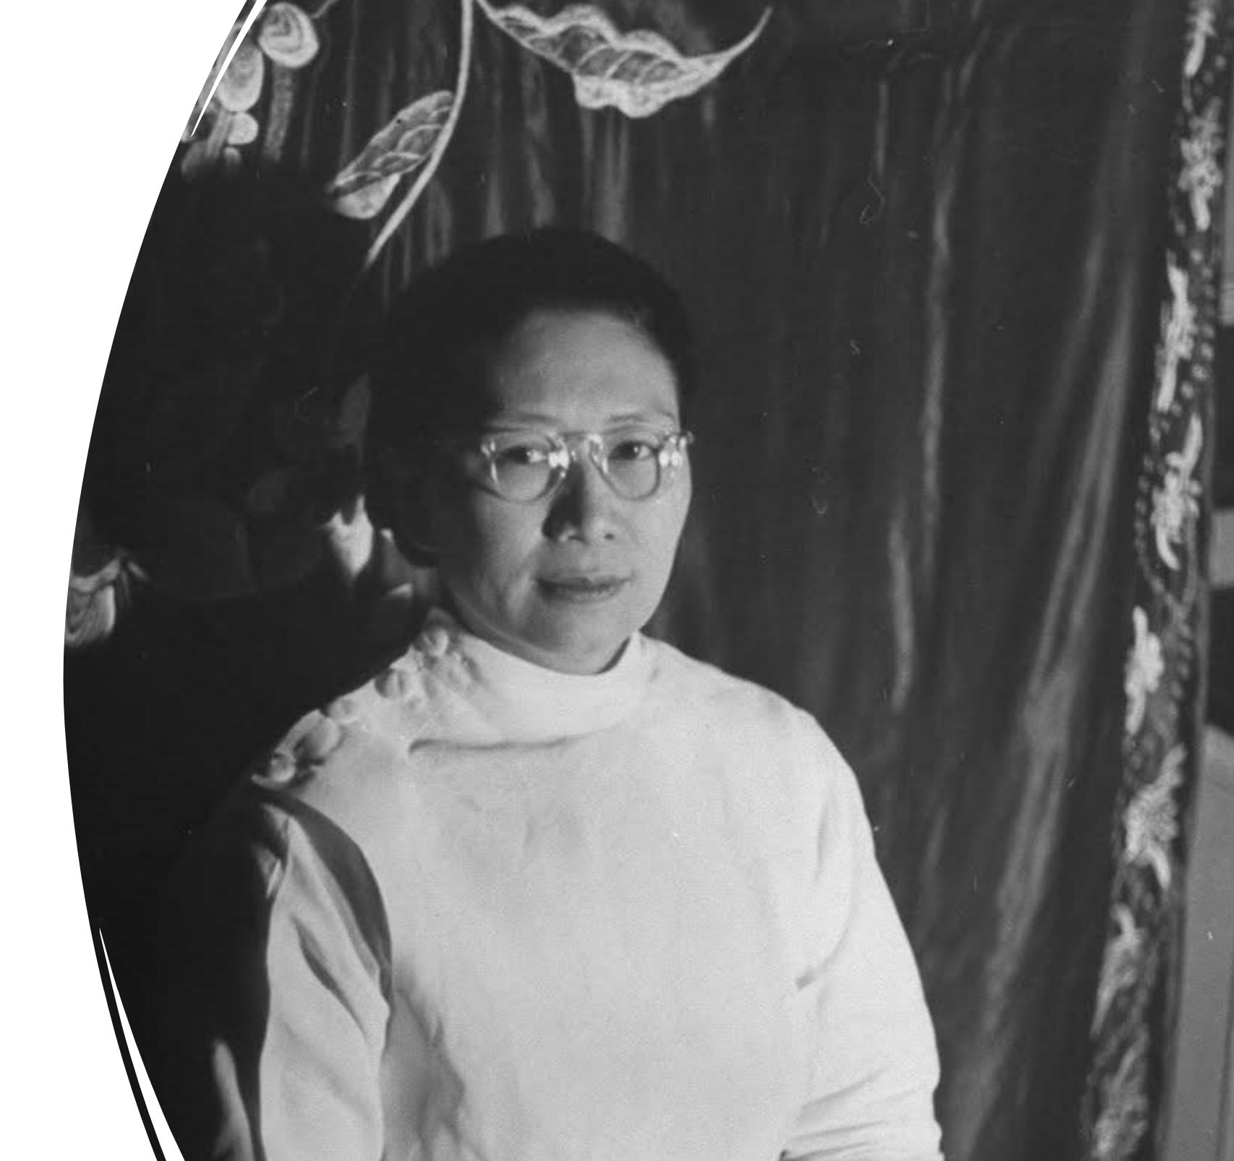
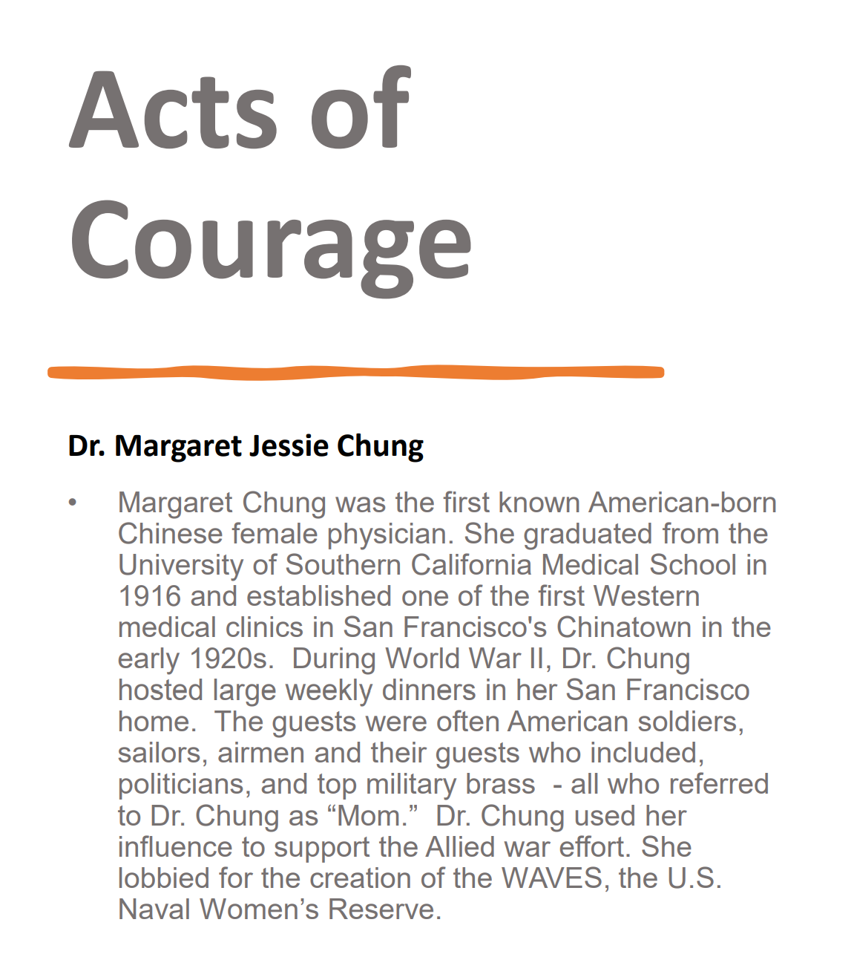

Slide 4
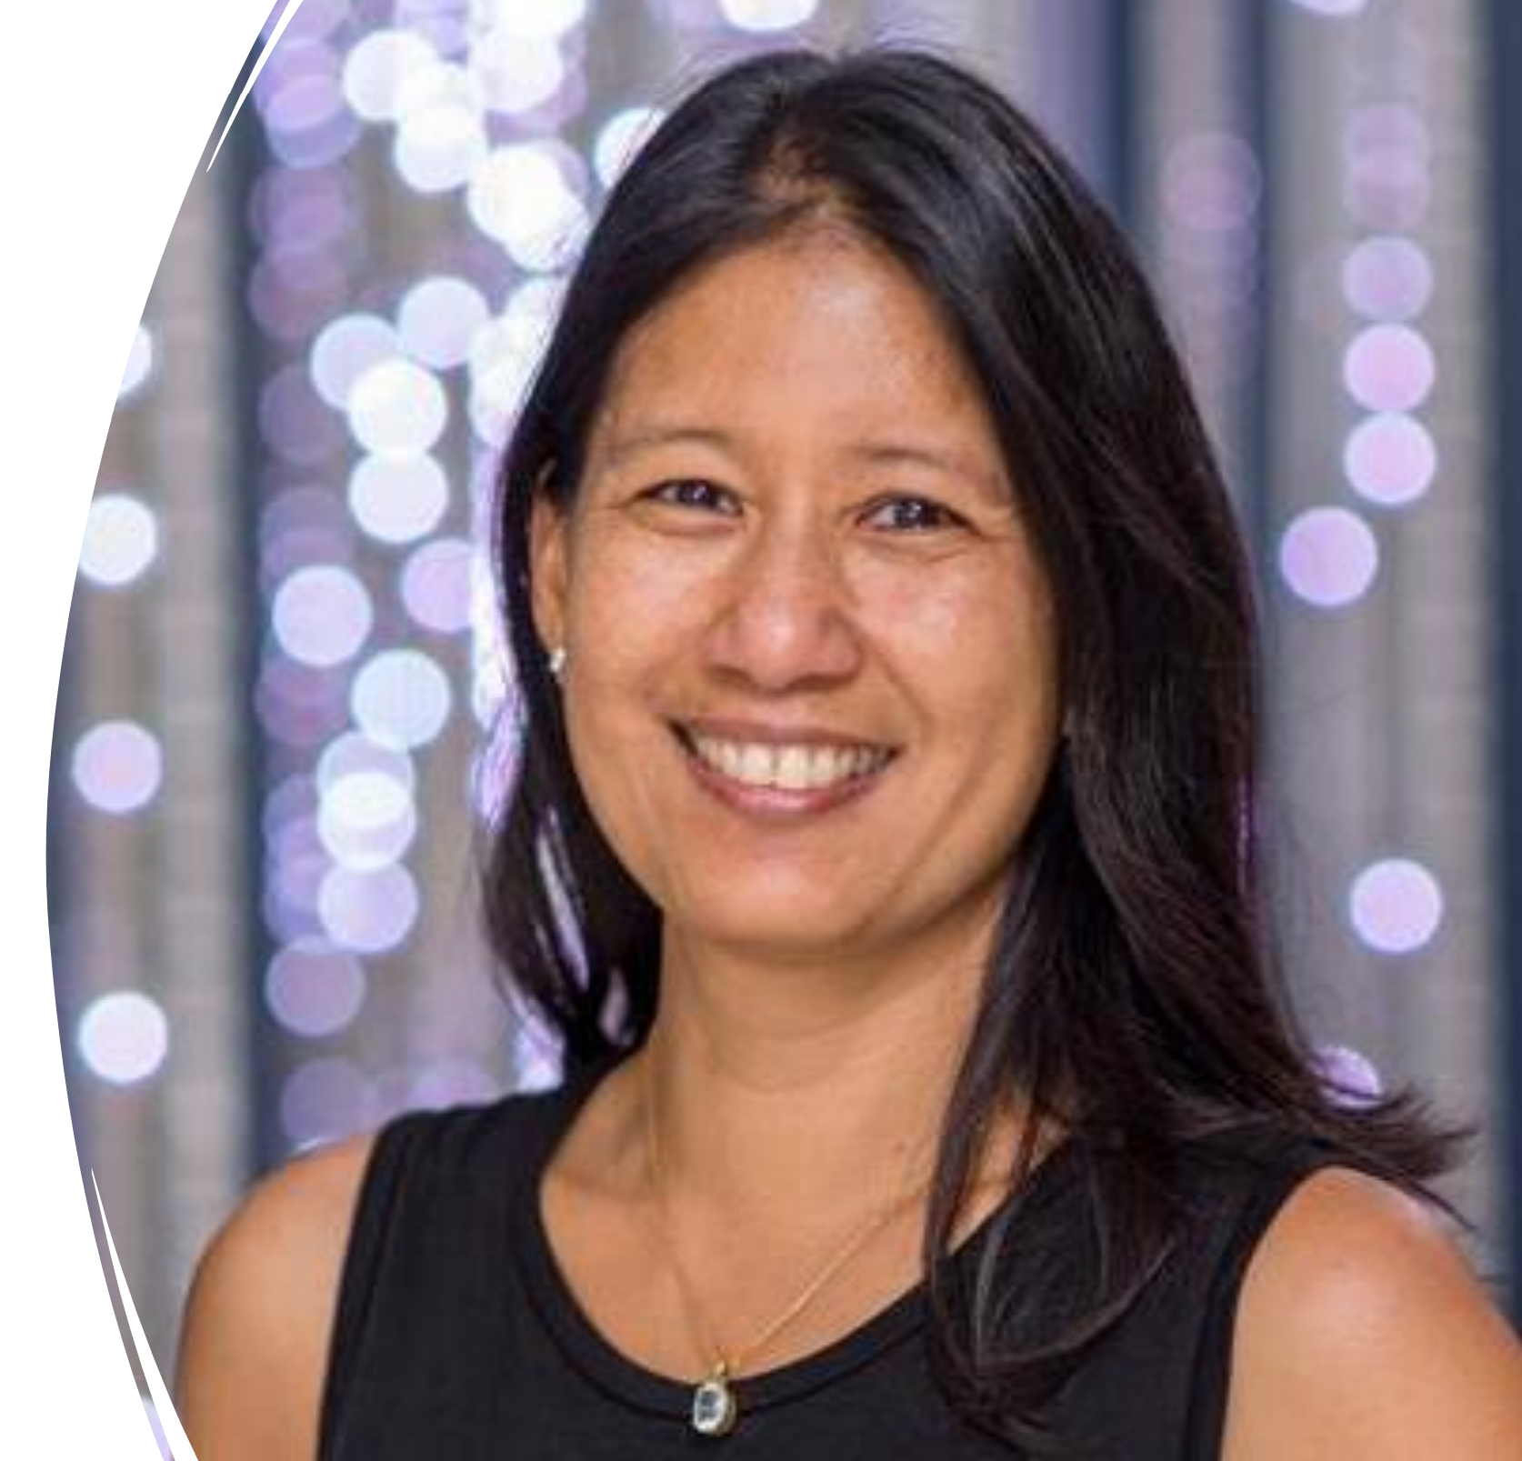
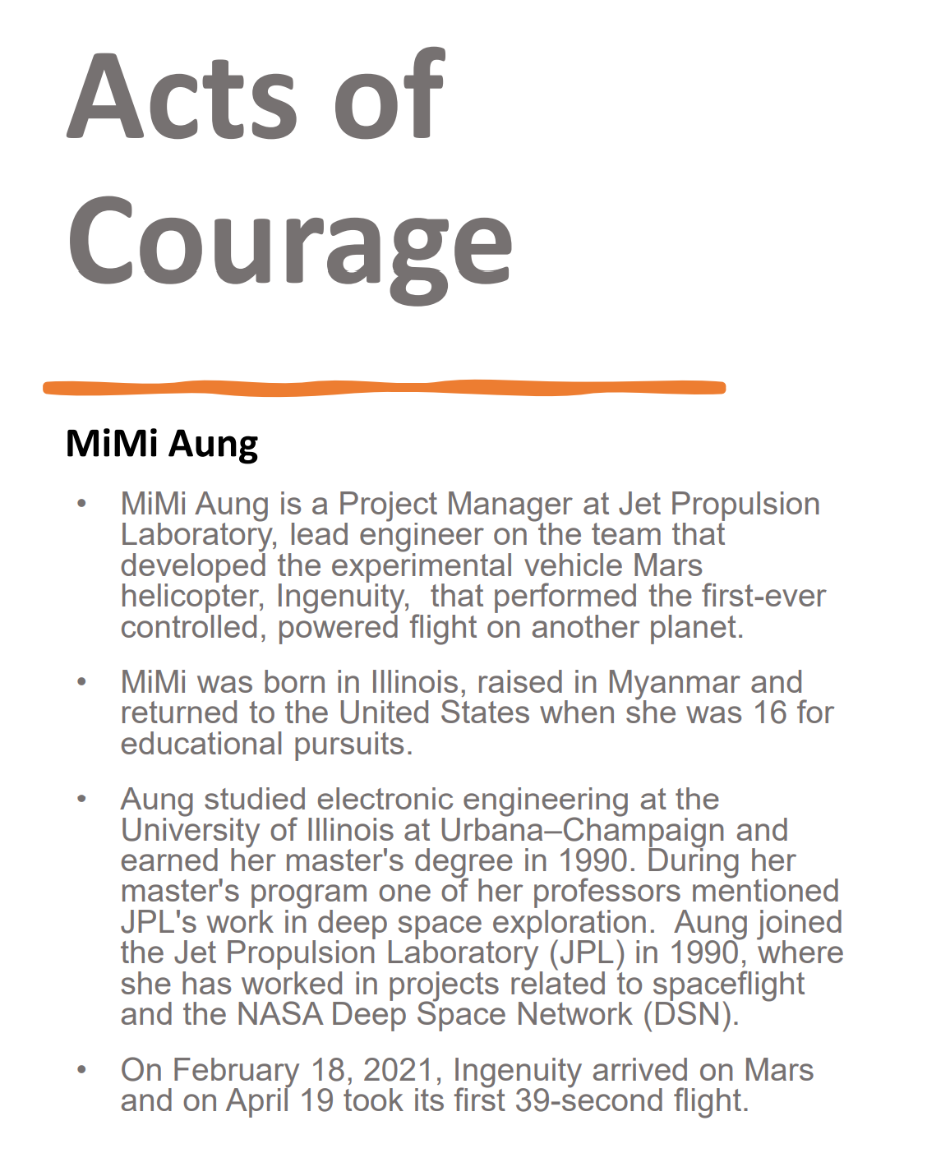

Slide 5
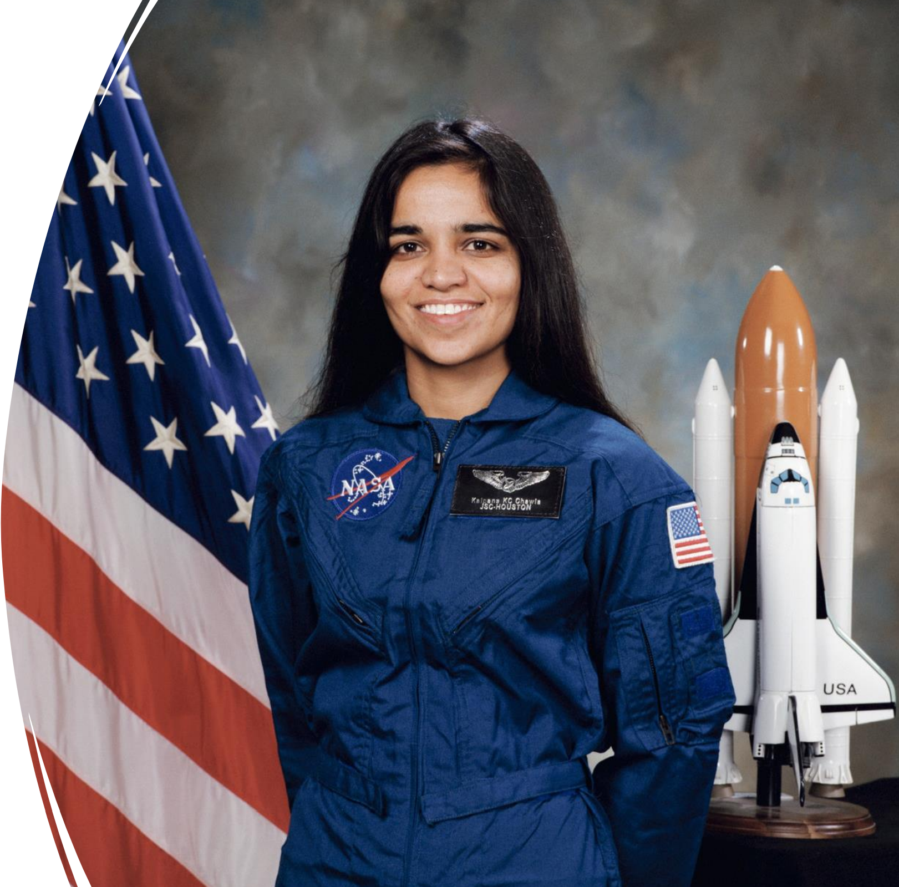
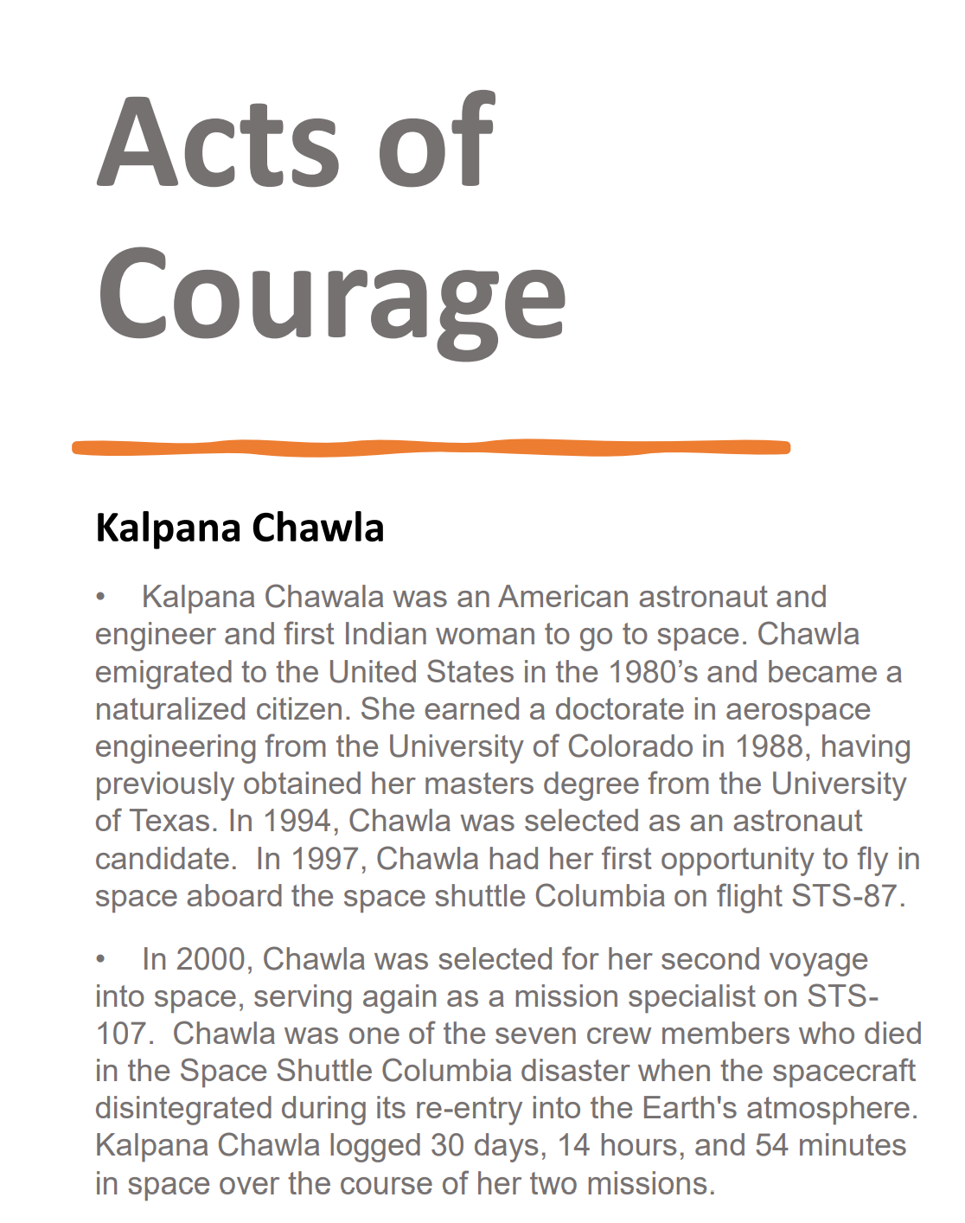

Slide 6
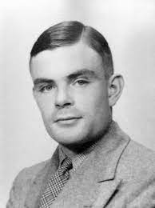
Acts of
Courage
Alan Turing 1912 - 1954
Alan Turing was a mathematician, logician, cryptanalyst and computer scientist. Turning is widely considered the father of computer science and artificial intelligence. During World War II, Turning designed a machine called the Bombe, which allowed the British to read all communications of the German naval force by decoding the Enigma cipher. The work of Turning and others at the Government Code and Cipher School shortened the war by two years, thus saving millions of lives.
He was a homosexual in a time when homosexuality was illegal. Despite his major contribution and service in the war effort, he was prosecuted in 1952 for “gross indecency,” stripped of his security clearance and of intelligence work. To avoid prison, Turing began chemical castration injections, and shortly after decided to take his own life at the age of 41.
Turing embodies both personal and national bravery, serving his country during a time his existence was a crime – his acts of courage will never be forgotten. His work in cryptography and computer science changed the world and his legacy continues to this day.

Slide 7
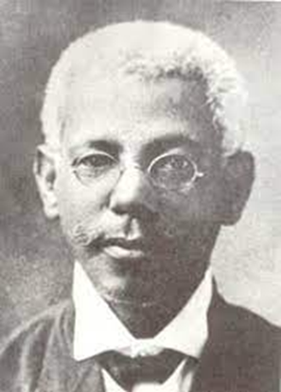
Acts of
Courage
Dr. José Celso Barbosa Alcala (1857 – 1921)
Dr. Barbosa was a Puerto Rican physician, sociologist and political leader. He is known as the father of the statehood movement in Puerto Rico and was the first Puerto Rican and one of the first persons of African descent to earn a medical degree in the United States. In 1877 Barbosa applied but was denied admission to the College of Physicians and Surgeons at Columbia University due to his race. He was admitted to the medical school of the University of Michigan, where he graduated as valedictorian of the class of 1880. Barbosa was the first person from Puerto Rico to earn a medical degree in the United States.
Dr. Barbosa returned to Puerto Rico in 1880 and made many contributions to medicine and public health. He initiated an early form of health insurance which encouraged employers to pay a fee to cover the future needs of their employees. In 1900 Barbosa was among the first five Puerto Rican leaders appointed to the Executive Cabinet under Governor Charles H. Allen, the first U.S. appointed civilian governor of Puerto Rico. Barbosa served in the Cabinet until 1917. From 1917–1921, Barbosa served in the first elected Puerto Rican Senate.

Slide 8
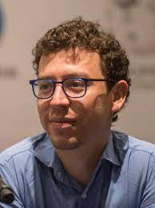
Acts of
Courage
Luis von Ahn (1978 - )
von Ahn is a Guatemalan entrepreneur and a consulting professor in the Computer Science Department at Carnegie Mellon University in Pittsburgh, PA. He is known as one of the pioneers of crowdsourcing and is the founder of reCAPTCHA, the system that enables web hosts to distinguish between human and automated access to websites. In 2009, von Ahn sold reCAPTCHA to Google. He is also the co-founder and CEO of Duolingo, the world's most popular language-learning platform. von Ahn’s research on CAPTCHAs and human computation has earned him numerous honors. He was awarded a MacArthur Fellowship in 2006. In 2018, von Ahn was awarded the LemelsonMIT prize for his "dedication to improving the world through technology."

Slide 9
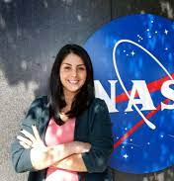
Acts of
Courage
Diana Trujillo Pomerantz (1983 - )
Trujillo is a Colombian aerospace engineer at the NASA Jet Propulsion Laboratory. She currently leads the engineering team at JPL responsible for the robotic arm of the Perseverance rover. Trujillo moved to the U.S. at when she was 17 with $300. In order to improve her English, she took classes at Miami Dade College while working as a housekeeper. On February 18, 2021, Trujillo hosted the first ever Spanish-language NASA transmission of a planetary landing, for the Perseverance rover landing on Mars.

Slide 10
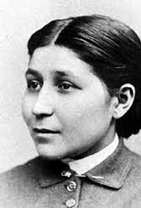
Acts of
Courage
Susan La Flesche Picotte (1865 – 1915)
La Flesche Picotte was a Native American doctor and reformer in the late 19th century. She is widely acknowledged as one of the first Indigenous peoples and the first Indigenous woman to earn a medical degree. She campaigned for public health and for the formal, legal allotment of land to members of the Omaha tribe.
La Flesche graduated second in her class from the Hampton Normal and Agricultural Institute in Virginia, now Hampton University and the Women’s Medical College of Pennsylvania. At 24 years old, she returned to the Omaha reservation and became the sole doctor for more than 1,200 people across 400+ miles.

Slide 11
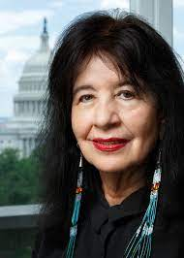
Acts of
Courage
Joy Harjo (1951 - )
Harjo is an American poet, musician, playwright, and author. She served as the 23rd United States Poet Laureate (2019-2022), and is the first Native American to hold the honor. She is also only the second Poet Laureate Consultant in Poetry to have served three terms. Harjo is a member of the Muscogee (Creek) Nation and belongs to Oce Vpofv (Hickory Ground). Harjo’s many honors include the Ruth Lily Prize for Lifetime Achievement from the Poetry Foundation, the Academy of American Poets Wallace Stevens Award, two NEA fellowships, and a Guggenheim Fellowship. In addition to her creative writing, Harjo has written and spoken about US political and Native American affairs. She is also an active member of the Muscogee Nation and writes poetry as “a voice of the Indigenous people.”

Slide 12
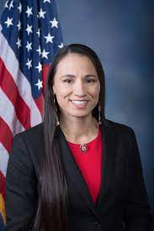
Acts of
Courage
Sharice Lynnette Davids (1980 - )
Davids serves as the U.S. representative from Kansas's 3rd congressional district (since 2019). She represents a district that includes most of the Kansas side of the Kansas City metropolitan area, including Kansas City, Overland Park, Prairie Village, Leawood, Lenexa, and Olathe. Elected in 2018 Davids, is the first openly LGBT Native American elected to the U.S. Congress, the first openly lesbian person elected to the U.S. Congress from Kansas, and one of the first of two Native American women elected to Congress, along with Deb Haaland of New Mexico. She is the second Native American to represent Kansas in Congress, after Charles Curtis, who was Herbert Hoover's vice president.

Slide 13
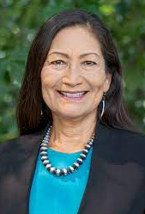
Acts of
Courage
Debra (Deb) Anne Haaland (1960 - )
Haaland serves as the 54th United States secretary of the interior. She previously served as chair of the New Mexico Democratic Party from 2015 to 2017 and as the U.S. representative for New Mexico's 1st congressional district from 2019 to 2021. Haaland is a Native American and an enrolled member of the Laguna Pueblo tribe. In December 2020, President-elect Biden nominated Haaland to serve as Secretary of the Interior. She was confirmed by the U.S. Senate in March 2021. Haaland is the first Native American to serve as a Cabinet secretary and the second to serve in the Cabinet, after Republican former vice president and Kaw Nation citizen Charles Curtis (1929 – 1933)

